Slide 2
Building a Single Page Application with ASP.NET and Angular.js
David CATUHE
Senior Program Manager
@deltakosh
Jon GALLOWAY
Senior SDE
@jongalloway

Slide 3

Agenda
ASP.NET Web API
First contact with Angular.js
Getting data
Routing and views
Real-time synchronization
Debug & Deployment

Slide 4
ASP.NET Web API and HTTP Services



HTML
JSON
XML
Web Forms
Web Pages
MVC
Web API
ASP.NET Core
Notes:
1. We’ve seen how ASP.NET provides a common core which supports several different toolsets.
2. [click for first animation] On the left side, we have tools which produce HTML, which will be viewed in browsers by people.
3. [click for second animation] On the right, we have Web API, which produces other formats which are consumed by machines (represented by this happy robot) – JSON, XML, and other custom formats which are read by JavaScript code, other programs, other servers, etc.

Slide 5
First contact with Angular.js
MVC framework
For Single Page Application You need only one script file:
<script src="angular.min.js"></script>
Latest version here:
http://code.angularjs.org/

Slide 6
First contact with Angular.js
angular.js
Module
Controllers
Dependencies Injection
$scope
Notes:
Angular.js is an MVC framework – strong separation between data and view through a controller
It uses dependencies injection to resolve dependencies
Demo – From scratch:
New html page
Add references
Ng-app
App.js
cardsController.js
Ng-controller dans la page
Binding simple avec ng-model

Slide 7
Getting data
angular.js
angular-resource.js
angular-animate.js
$http
$resources
Filters
Animation
Notes:
Demo:
Web request through $http
Moving to localServices.js to use angular-resource with $resources
Adding local filter <Perhaps a call to webAPI here?>
Adding animations (angular-animate)

Slide 8
Routing and views
angular.js
angular-resource.js
angular-animate.js
angular-route.js
SPA uses views to build UI
Angular.js uses routing to define views
Notes:
Demo:
Moving current content to list.html
Adding a ng-view tag
Adding routing to app.js (angular-route)
New view detail.html

Slide 9
Real-time synchronization
angular.js
angular-resource.js
angular-animate.js
angular-route.js
Using localStorage
Difference between getting data and synchronization
SignalR
Notes:
Demo:
Add dual-binding in detail
Ng-change to update locally
Reload changes at start
Using signalR to do a real time sync

Slide 10
Typography
This could be a pithy summary of your slide content, or a single phrase to describe the main idea
Titles are 48pt Segoe UI Light and sentence case. They do not use periods.
All text 28pt and above (including this content) is in Segoe UI Light. The smallest font you should use is 14pt, and in Segoe UI (body).
Second level not bulleted, 14pt Segoe UI (body) like this.
Multiple bullets would look like this.
Third level are bullets, like this.
Font is gray (RGB 64,64,64) on white slides.

Slide 11
Color palette and tools
Lead and accent colors have been formatted into this template.
In general, use white or dark blue for all slide backgrounds.
When building other graphics like tables and charts, please utilize the color palette provided within this template. The first 6 colors in the sub-tiles to the right.
//build/ template background colors
RGB
255 255 255
RGB
0 24 143
//build/ template color palette and Windows brand colors
RGB
0 24 143
RGB
0 188 242
RGB
155 79 150
RGB
127 186 0
RGB
255 140 0
RGB
0 216 204
RGB
232 17 35
RGB
186 216 10
RGB
255 175 0
RGB
244 114 208
Presentation tools
Find Photography, device renders and images, logos, and more here
Additional Microsoft brand images here (click ‘browse photography’ at top right)

Slide 12
Content slides

Slide 13
Typography
This could be a pithy summary of your slide content, or a single phrase to describe the main idea
Titles are 48pt Segoe UI Light and sentence case. They do not use periods.
All text 28pt and above (including this content) is in Segoe UI Light. The smallest font you should use is 14pt, and in Segoe UI (body).
Second level not bulleted, 14pt Segoe UI (body) like this.
Multiple bullets would look like this.
Third level are bullets, like this.
Font is gray (RGB 64,64,64) on white slides.

Slide 14
Typography (color back option)
This could be a pithy summary of your slide content, or a single phrase to describe the main idea.
Titles are 48pt Segoe UI Light and sentence case. They do not use periods.
All text 28pt and above (including this content) is in Segoe UI Light. The smallest font you should use is 14pt, and in Segoe UI (body).
Second level not bulleted, 14pt Segoe UI (body) like this.
Multiple bullets would look like this.
Third level are bullets, like this.
Font is white (RGB 255,255,255) on dark blue slides.

Slide 15
Special emphasis content, like a quote or statement, can appear in this location on the slide, at 48pt. Avoid running text from one edge of the page to the other. Do not use this slide for bulleted content.

Slide 16
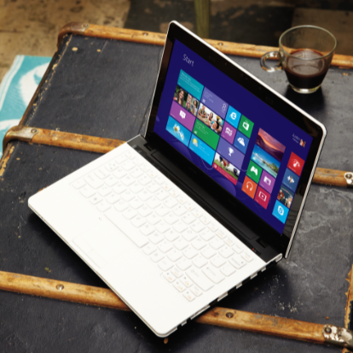
Picture shape with title
Text would go here.
To add your own image, right click the thumbnail view of this slide and select New Slide.
Click the picture icon, as directed, to add a new image.

Slide 17
Color shapes can hold messaging
Use the Format Shape menu to change the color of the shape.
This text box will automatically center to align beside the color shape.

Slide 18
Color shapes can hold messaging
Color back option.
Use the Format Shape menu to change the color of the shape.
This text box will automatically center to align beside the color shape.

Slide 19
Demo title (use for demo intros)

Slide 20
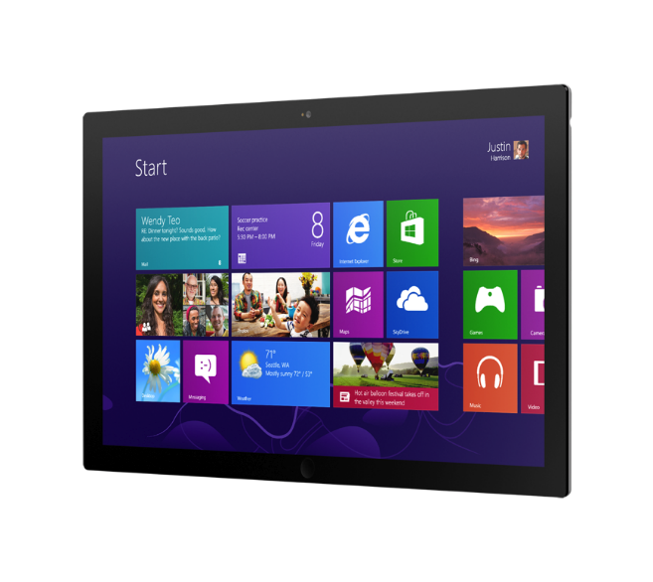
Single device preferred angle. This is another option for displaying a hardware image that sits at an angle.

Slide 21
Charts and code (this is a divider slide)

Slide 22
Charts
For content: Type is what articulates the message. Text doesn’t need to be bulleted. Text size can reinforce and impact.

Slide 23
Charts
For content: Type is what articulates the message. Text doesn’t need to be bulleted. Text size can reinforce and impact.

Slide 24
Table
Column 1 | Column 2 | Column 3 | Column 4 | Column 5
Text | Text | Text | Text | Text
Text | Text | Text | Text | Text
Text | Text | Text | Text | Text
Text | Text | Text | Text | Text
Text | Text | Text | Text | Text
Text | Text | Text | Text | Text
Text | Text | Text | Text | Text
Text | Text | Text | Text | Text
This is a content box, always 24pts and sentence case.

Slide 25
Diagram with text
This is a content box, always 24pts and sentence case.
Windows Metro Style App
<audio src=“…”>
<video src=“…”>
Windows Runtime (WinRT)
Playback/Preview
(Media Engine)
Capture
(Capture Engine)
Transcode
Streaming
(Sharing Engine)
Media Foundation
Audio/Video
Source
Video
Decoder
Video
Effect 1
Video
Effect N
Video
Encoder
Audio/Video
Sink
Audio
Decoder
Audio
Effect 1
Audio
Effect N
Audio
Encoder

Slide 26
Diagram without text
New Windows 8 app
<audio src=“…”>
<video src=“…”>
Windows Runtime (WinRT)
Playback/Preview
(Media Engine)
Capture
(Capture Engine)
Transcode
Streaming
(Sharing Engine)
Media Foundation
Audio/Video
Source
Video
Decoder
Video
Effect 1
Video
Effect N
Video
Encoder
Audio/Video
Sink
Audio
Decoder
Audio
Effect 1
Audio
Effect N
Audio
Encoder

Slide 27
Slide title here
Code content here in 24pt Consolas font. Always use this white slide for code.

Slide 28
Screenshots

Slide 29
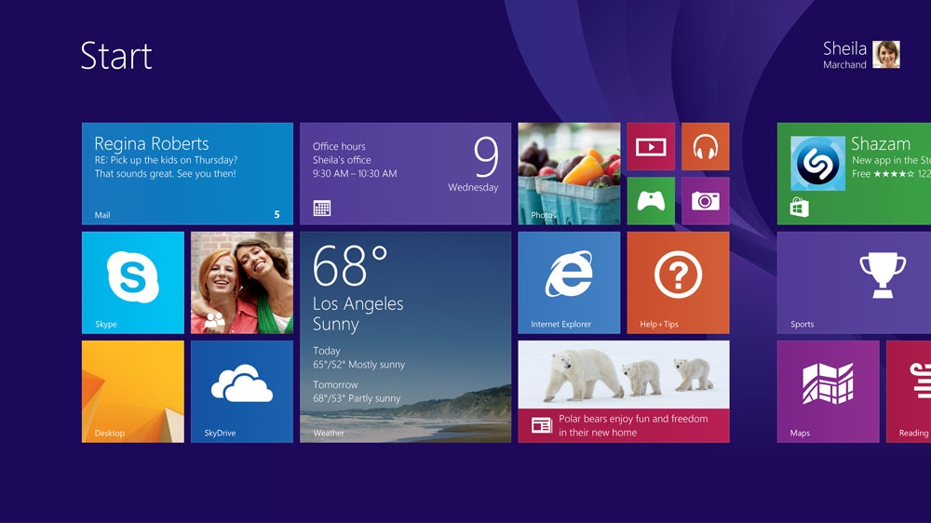

Slide 30
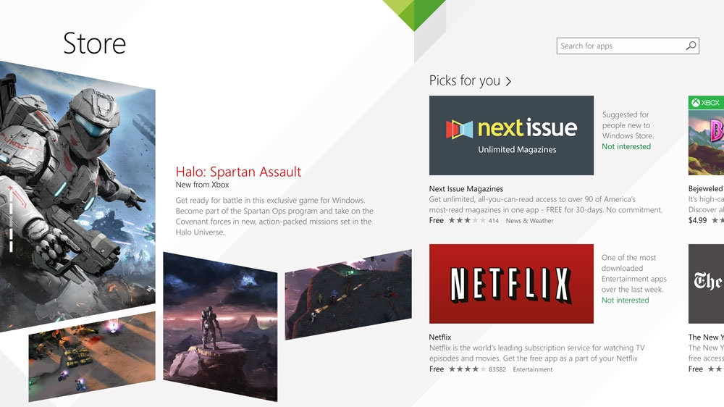

Slide 31
Resources
Use this slide to list resources, white papers, videos and links.

Slide 32
Resources (color back option)
Use this slide to list resources, white papers, videos and links.

Slide 33

© 2014 Microsoft Corporation. All rights reserved. Microsoft, Windows, Windows Vista and other product names are or may be registered trademarks and/or trademarks in the U.S. and/or other countries.
The information herein is for informational purposes only and represents the current view of Microsoft Corporation as of the date of this presentation. Because Microsoft must respond to changing market conditions, it should not be interpreted to be a commitment on the part of Microsoft, and Microsoft cannot guarantee the accuracy of any information provided after the date of this presentation. MICROSOFT MAKES NO WARRANTIES, EXPRESS, IMPLIED OR STATUTORY, AS TO THE INFORMATION IN THIS PRESENTATION.

